Slide 1
Image Encryption using DNA Encoding, Feistel Transformation and Hill Encryption
Supervisor:
Er. Rajesh Tripathi
CS-26
Siddharth Majumdar [20164044]
Sunil Kumar [20164012]
Saurabh [20164104]
Pradyumna Pandey [20164159]

Slide 2
Contents
Motivation
Chaotic Sequences
Hill Cipher Encryption
Pixel Scrambling
Dynamic DNA Encoding
Image Encryption Algorithm
Sample Encryption
Analysis of Encryption
Future Scope
References

Slide 3
Motivation
Cyber Security : A Major Issue in Today’s World
Implementation of a multifold security-providing algorithm
Utilizing the massive data storage capacity and high parallel computing power of DNA in encryption

Slide 4
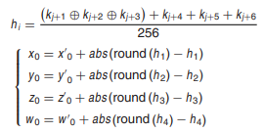

Chaotic Sequences
Chaotic sequences help in generating random values
A small change in initial values causes a big deviation in the later values
Generation of a hash key value K using SHA-3(Keccak)
Splitting the key K into blocks k_{j} which are used in the adjacent formulae
Initial values of x’₀, y’₀, z’₀, w’₀ is 0.00000005, and
j = 6(i - 1), i = 1, 2, 3, 4

Slide 5
Hill Cipher Encryption
In classical cryptography, the Hill cipher is a polygraphic substitution cipher based on linear algebra.
Multiple 4 × 4 reversible matrices M_{i} are constructed, then the Hill encryption is performed on each block of pixels from the image.
The image which is to be encrypted is divided into blocks with 4 pixels in
each block, and the each block of pixel is converted into 4 × 1 matrix, I.

Slide 6
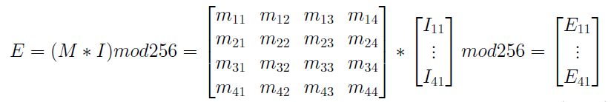


Construction of Hill Encryption Matrix
The B₄ sequence generated is used to fill sub-matrix M₁₁.
Sub-matrix M₁₂ = I - M₁₁
Sub-matrix M₂₂ = - M₁₁
Sub-matrix M₂₁ = I + M₁₁

Slide 7
Pixel Scrambling
Utilizing the chaotic sequence B₁ for implementing pixel scrambling
Selection of a pixel from the sub-matrix of a particular pixel and exchanging its values
Pixel position selection formula depends on the values of the chaotic sequence and is as follows:
i’ = i + [B₁[i]*10⁸]mod(M-i)
j’ = j + [B₁[j]*10⁸]mod(N-j)
where the image matrix is of M*N pixels and i < M and j < N

Slide 8

Dynamic DNA Encoding
Involves the usage of the 4 nucleotides in DNA : Adenine, Guanine, Cytosine and Thymine
Pixel matrix encrypted using one of the 8 rules depending upon the pixel position.
DNA encoding rule R(i,j) for the pixel P(i,j) is calculated as follows :
R(i,j) = Mod((i − 1) ∗ n + j, 8) + 1.
Where i ∈ {1, 2, 3, ..., m}, j ∈ {1, 2, 3, ..., n}

Slide 9
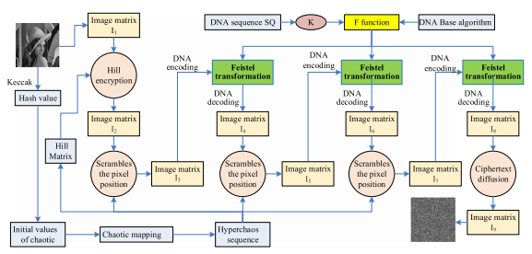
Image Encryption Algorithm

Slide 10
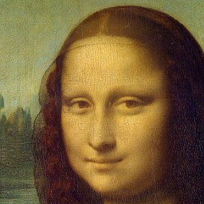


Sample Encryption
Original Image
Hill Encrypted Image
Pixel Scrambled Image

Slide 11
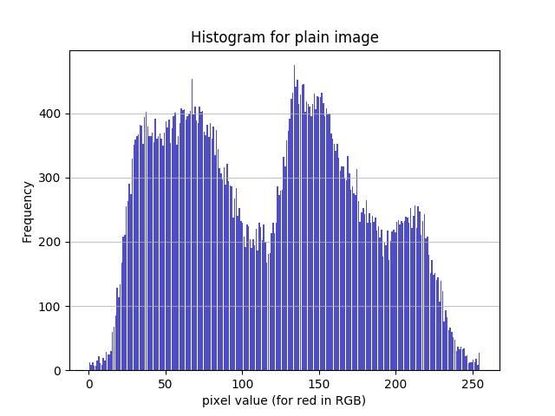
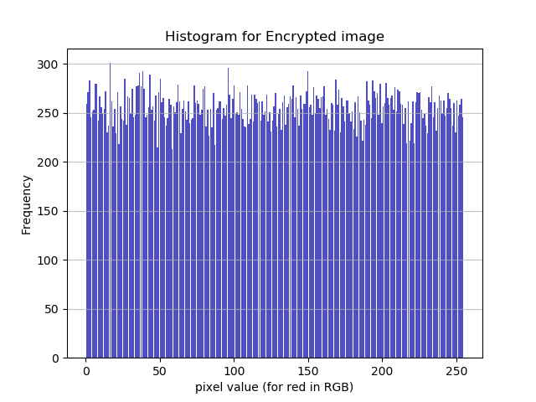
Analysis of Encryption
The histogram analysis of the pixel values for red in RGB in the plain and encrypted images clearly shows the pixel distribution of the encrypted image is very uniform, showing that the method has a good ability to resist the statistical analysis in such a way that the attacker cannot analyse the original pixel value distribution range. Quantitatively, the variance reduces from 18181.57 in the plain image to 243.84 in the encrypted image.

Slide 12
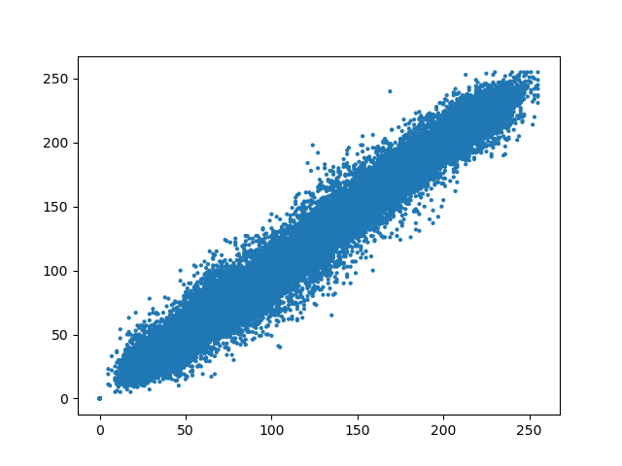
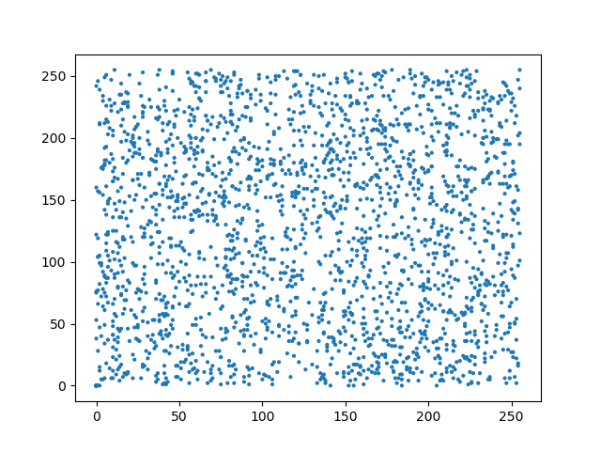
Analysis of Encryption
The correlation coefficient (vertical) analysis of the plain image(left) and encrypted image (right) shows a significant reduction in the correlation between pixels in the vertical direction, which signifies its resistance to statistical analysis attacks, as the attacker won’t be able to determine adjacent pixels on the basis of values of other pixels.

Slide 13
Future Scope
Implementation of Feistel transformation rounds
Implementation of ciphertext diffusion
Implementation of decryption steps

Slide 14
References
[1] X. Zhang, Z.Zhou and Y. Niu, “An Image Encryption Method Based on the Feistel Network and Dynamic DNA Encoding,” IEEE Photon. J., vol. 10, no. 4, Aug. 2018, Art no. 2859257
[2]S.Sun, “A Novel Hyperchaotic Image Encryption Scheme Based on DNA Encoding, Pixel Level Scrambling and Bit-Level Scrambling”, IEEE Photon. J., vol. 10, no. 2, Apr. 2018, Art no. 2817550

Slide 15
Thank You

